Slide 1

CS 4981 Data Science TBA Final Project
By Draven Schilling

Slide 2
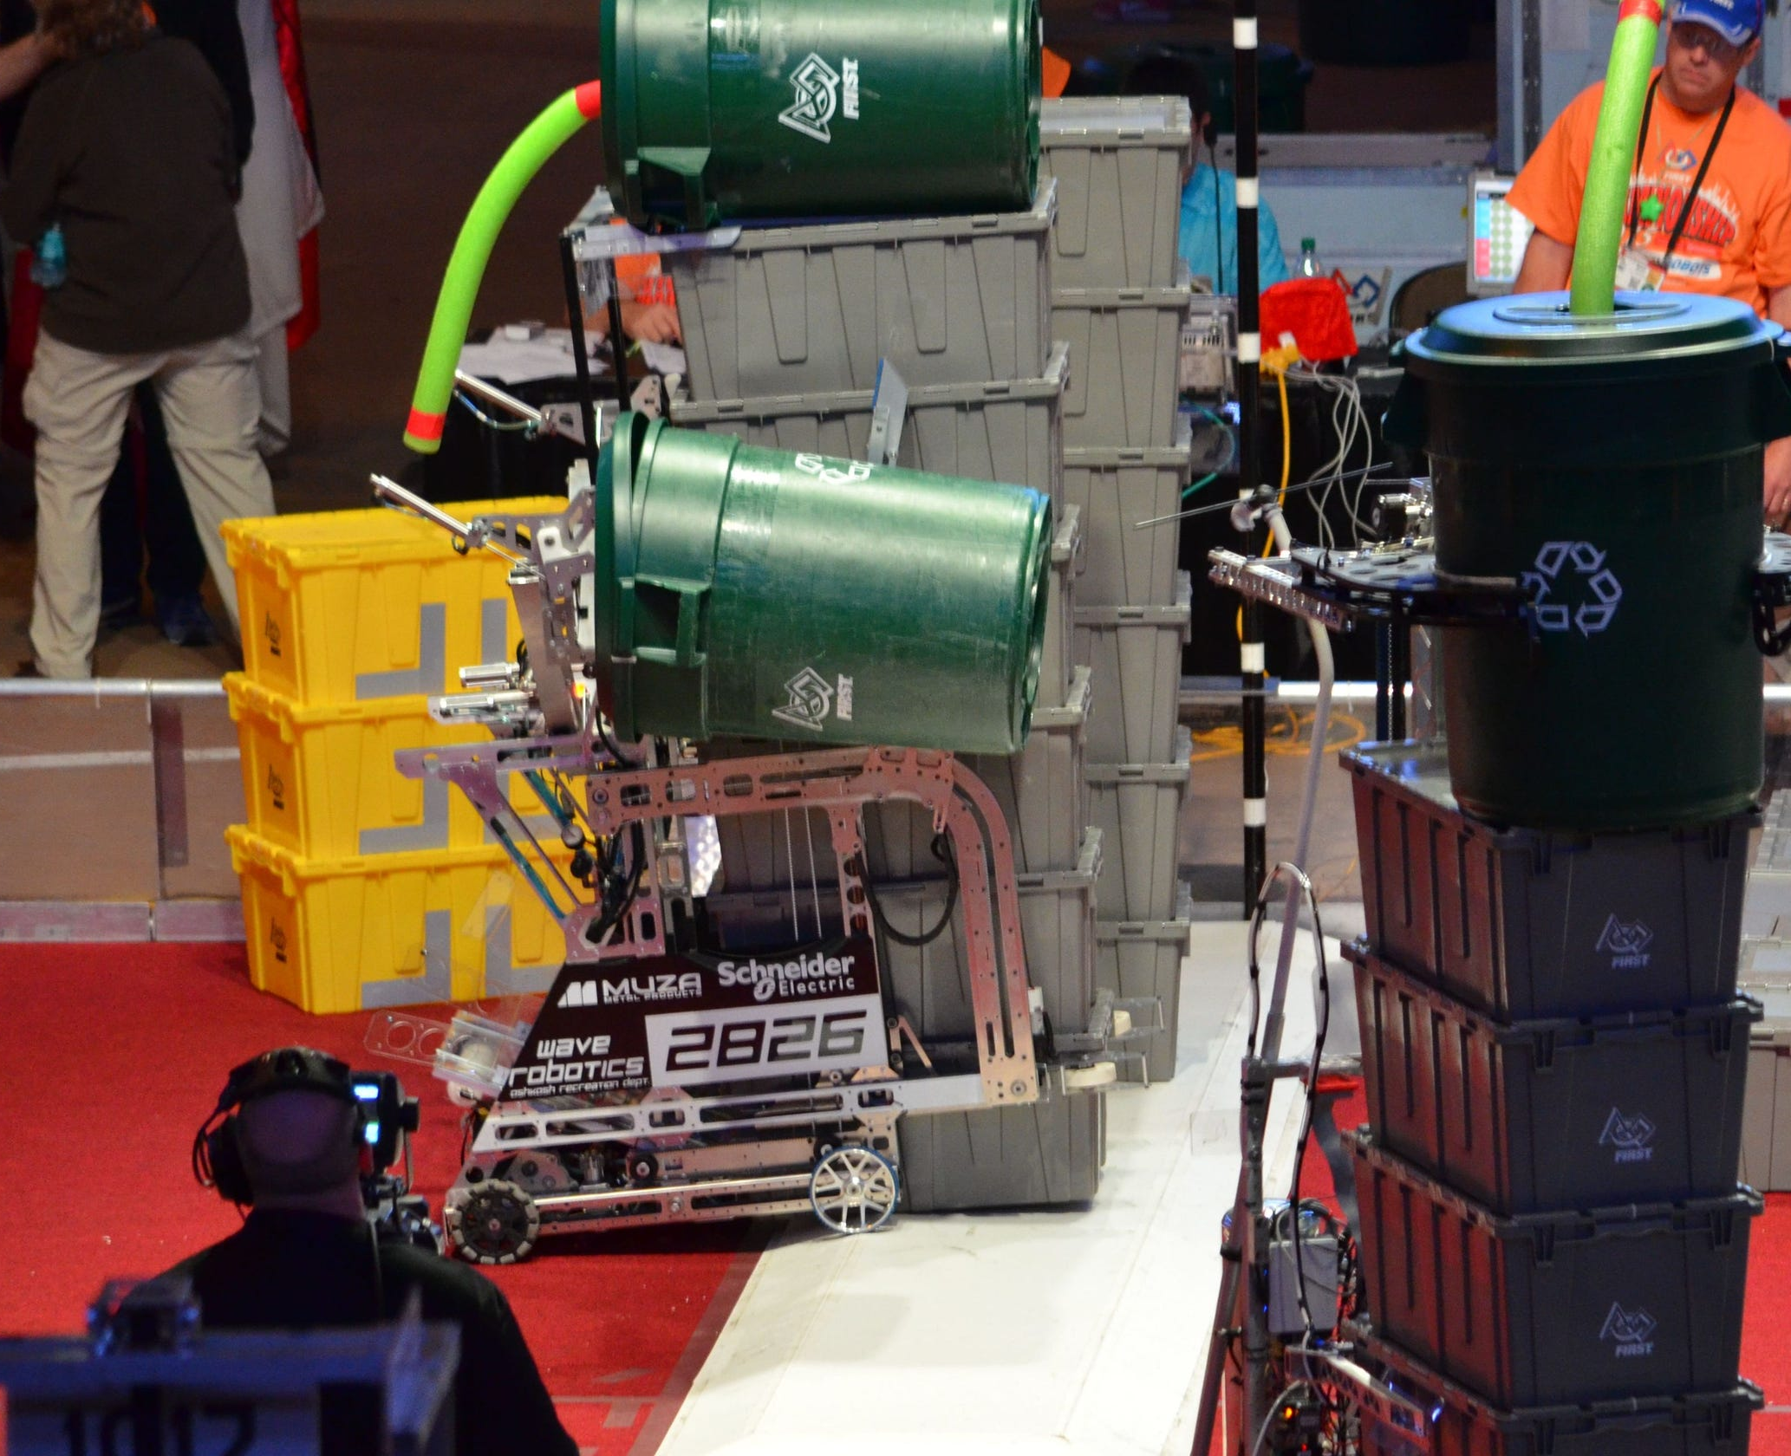
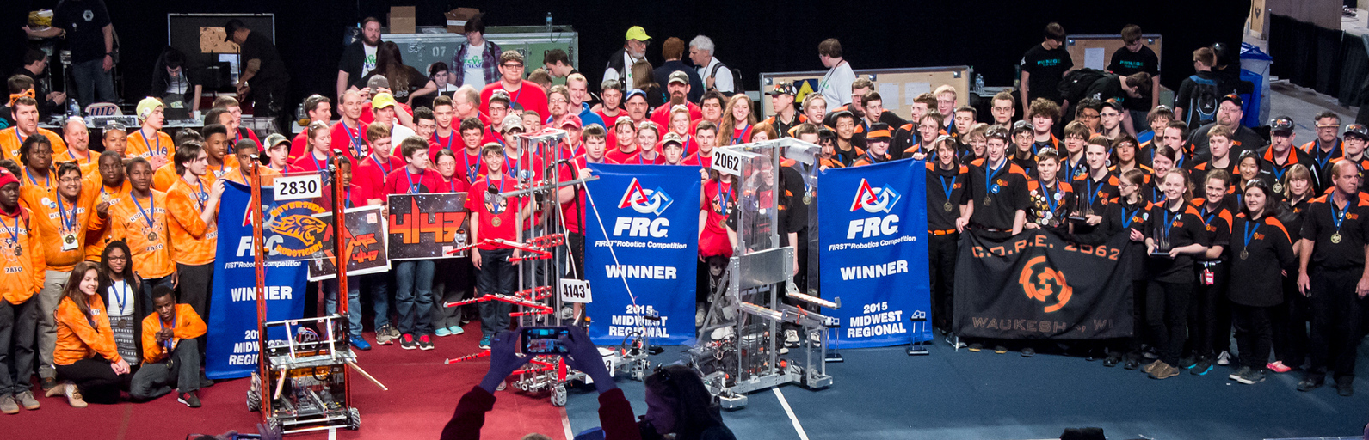
Background
What is FRC?
Why scouting?
TBA API

Slide 3
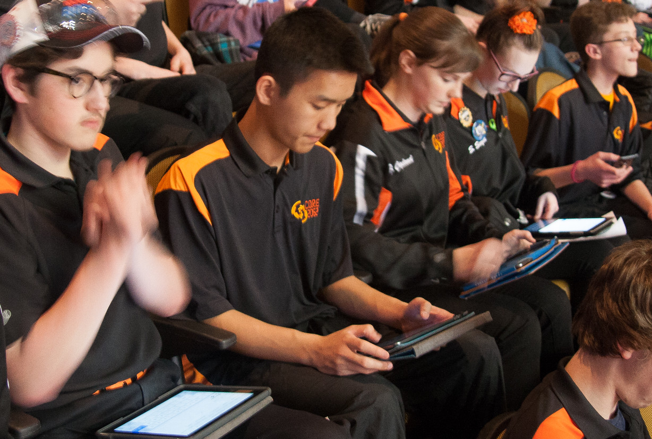
Problem / Current Method
What makes the most successful team?
Features to focus on year-to-year
Many FRC teams lack manpower for scouting
May need a picklist on demand
Many teams currently pick based on rank
Why do we care about picklists?

Slide 4
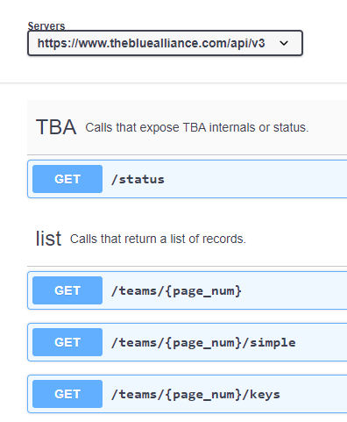
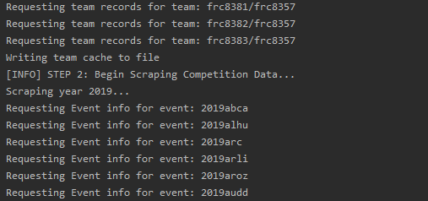
Scraping Data
Python requests and JSON libraries
HTTPS requests to TBA endpoint
Team and event data
Attempt 1:
Missing data galore
Attempt 2:
EDA inconclusive
Entry per competition
unnecessary?
Attempt 3:
HL Team Summary Statistics
Good Enough?
https://www.thebluealliance.com/apidocs/v3
https://github.com/Ivendrakeo/CS4981-TBA-Scraper

Slide 5
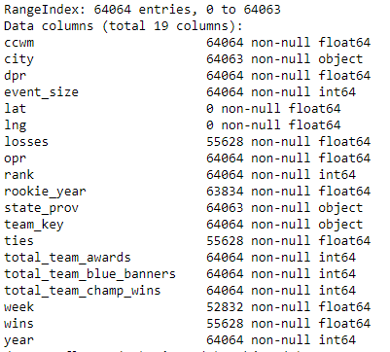
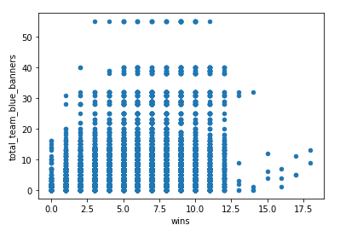
Iterative Scraping

Slide 6
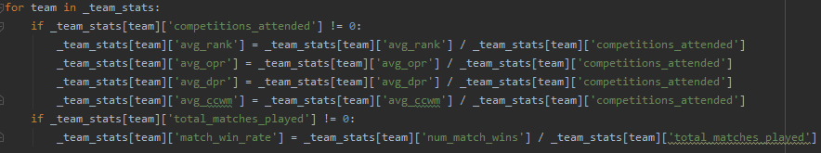
Data Pre-Processing
TBA doesn’t facilitate team info
Pre-processing upon scraping
Win rate, avg OPR…
Reduce duplicated rows
Reduce pre-processing in Jupyter
Missing Values
Only Categorical
Mean? Mode? Unknown?

Slide 7
EDA - What have we learned?
TBA interpreted statistics are not great predictors at the high level
Rank and match win rate is strongly correlated with number of wins as we would expect. This supports the traditional pick list model based on rank.
How old a team is does not always make them better. Though only older teams are the most successful.
There may be regions of particularly successful teams, though further investigation is needed.

Slide 8
EDA
4 major take away’ s…
What did we learn?

Slide 9
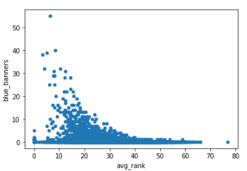
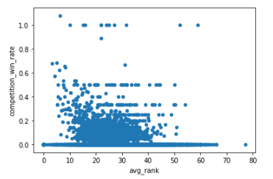
Total wins vs win rate
Total number of blue banners are going to be a better predictor (in our case) than average win rate

Slide 10
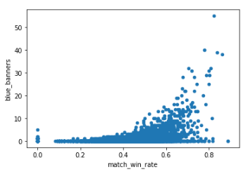
Match win rate
Rank and match win rate is strongly correlated with number of wins as we would expect. This supports the traditional pick list model based on rank.

Slide 11
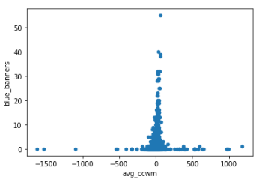
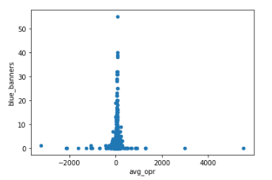
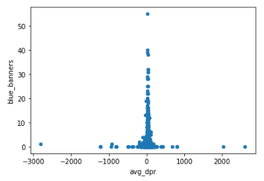
TBA stats
TBA interpreted statistics are not great predictors at the high level

Slide 12
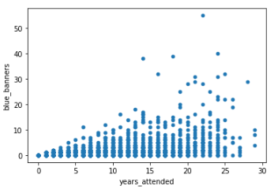
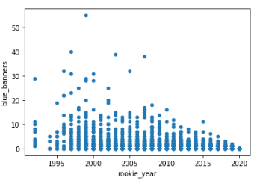
Team age
How old a team is does not always make them better. Though only older teams are the most successful.

Slide 13
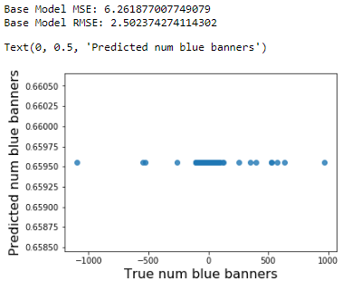
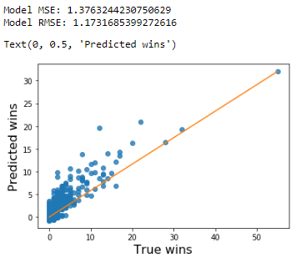
ML Modeling
Regression using blue banners as dependent variable
More so interested in feature detection and not end model
Awards, years attended, champ wins, match win rate

Slide 14
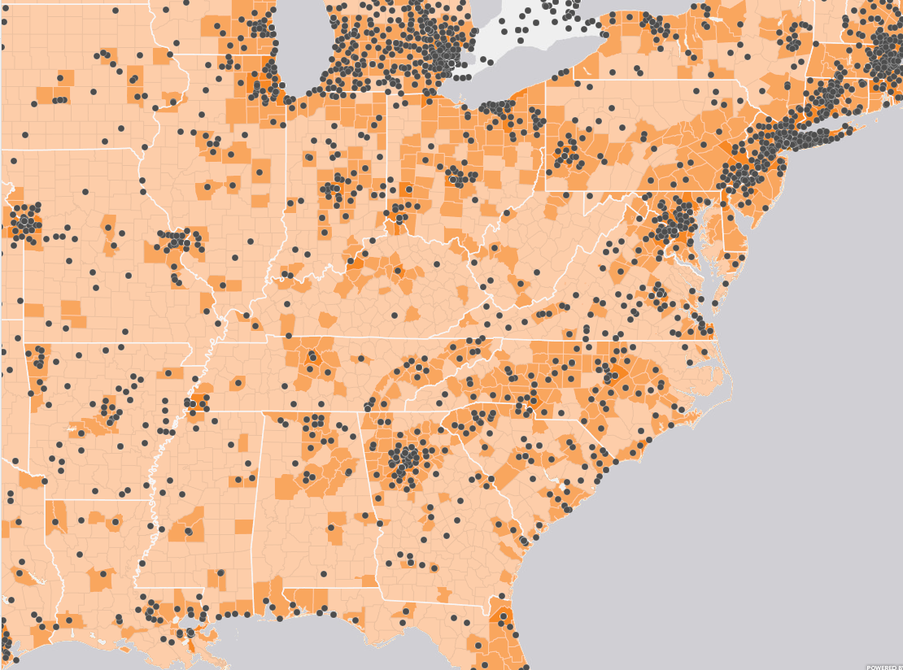
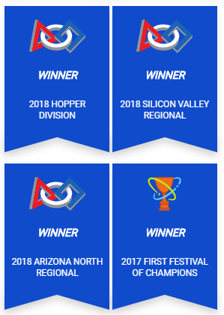
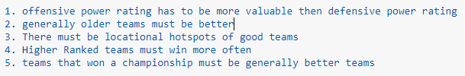
Going Further
Apply these methods on a yearly basis
Look at regional data
Inner team trends
Apply ML model to actual competition results

Slide 15
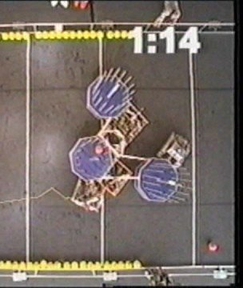
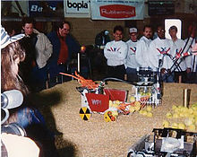
Conclusion
Is historic data a useful predictor?
Better than TBA stats
Another factor to consider

Slide 16
Questions?

